Slide 1
House Prices
Regression Model

Slide 2
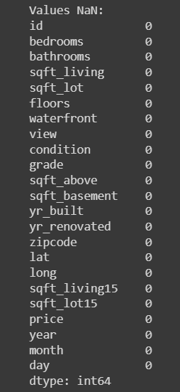
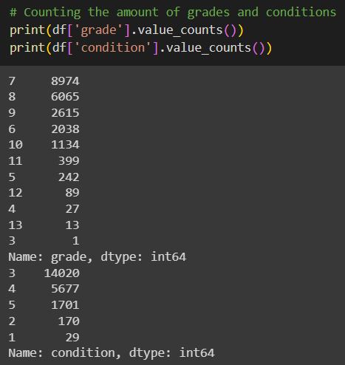
Data Cleaning
On our first approach to the data que saw that we don't need so much data cleaning. We did the usual approach to the data, with the info, columns, categorical and numerical values to have an idea on how the data is stored and managed.

Slide 3
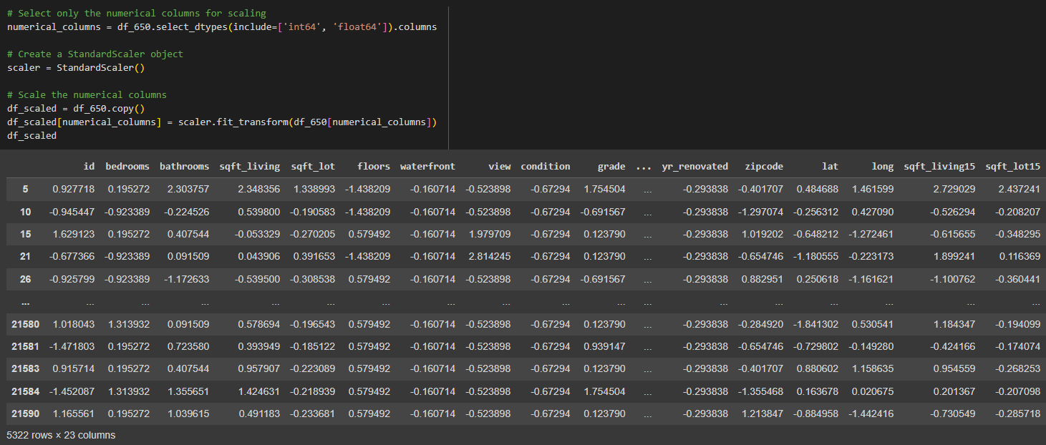
Data Cleaning
During our exploration of the data we proceed to scale the categorical and numerical columns:

Slide 4
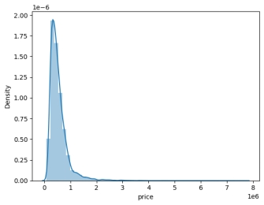
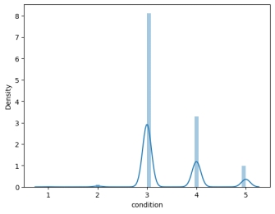
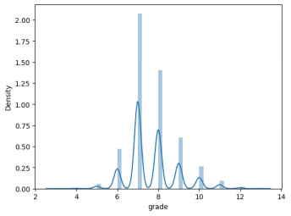
Plots
The data is well organised and we notice that we don't have nulls and duplicates.
So we proceed to prepare all for the EDA with some plots.
Some of the early plots we did like this gave us some insights like the density related with the price, condition and grade. Values we considered important for their relation with the price.

Slide 5
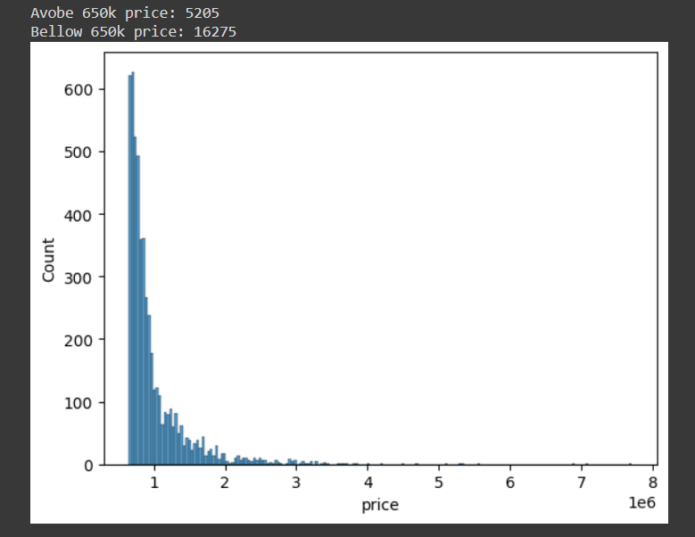
Plots
One of our principal concerns was to determine the amount of houses with the price above 650k. We created a code to determine how many were above and below that price and show it with a plot:

Slide 6
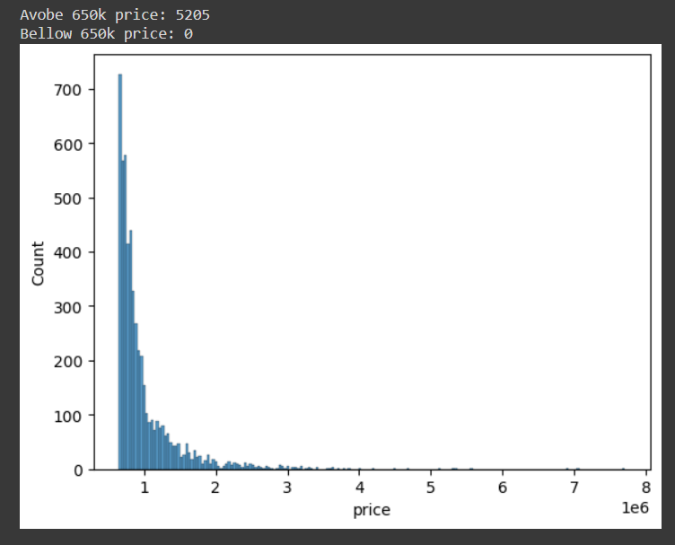
Plots
After that we determine that we could work with only the amount above 650k for our training model as our client requested:

Slide 7
Machine Learning
As usual we started creating the heat map for the clean data. Followed by our first linear regression, and benchmarking the data before the training.
We compared the price value with several other values to have an idea on how important it was for our client and determine some insights of the housing problems we could have.

Slide 8
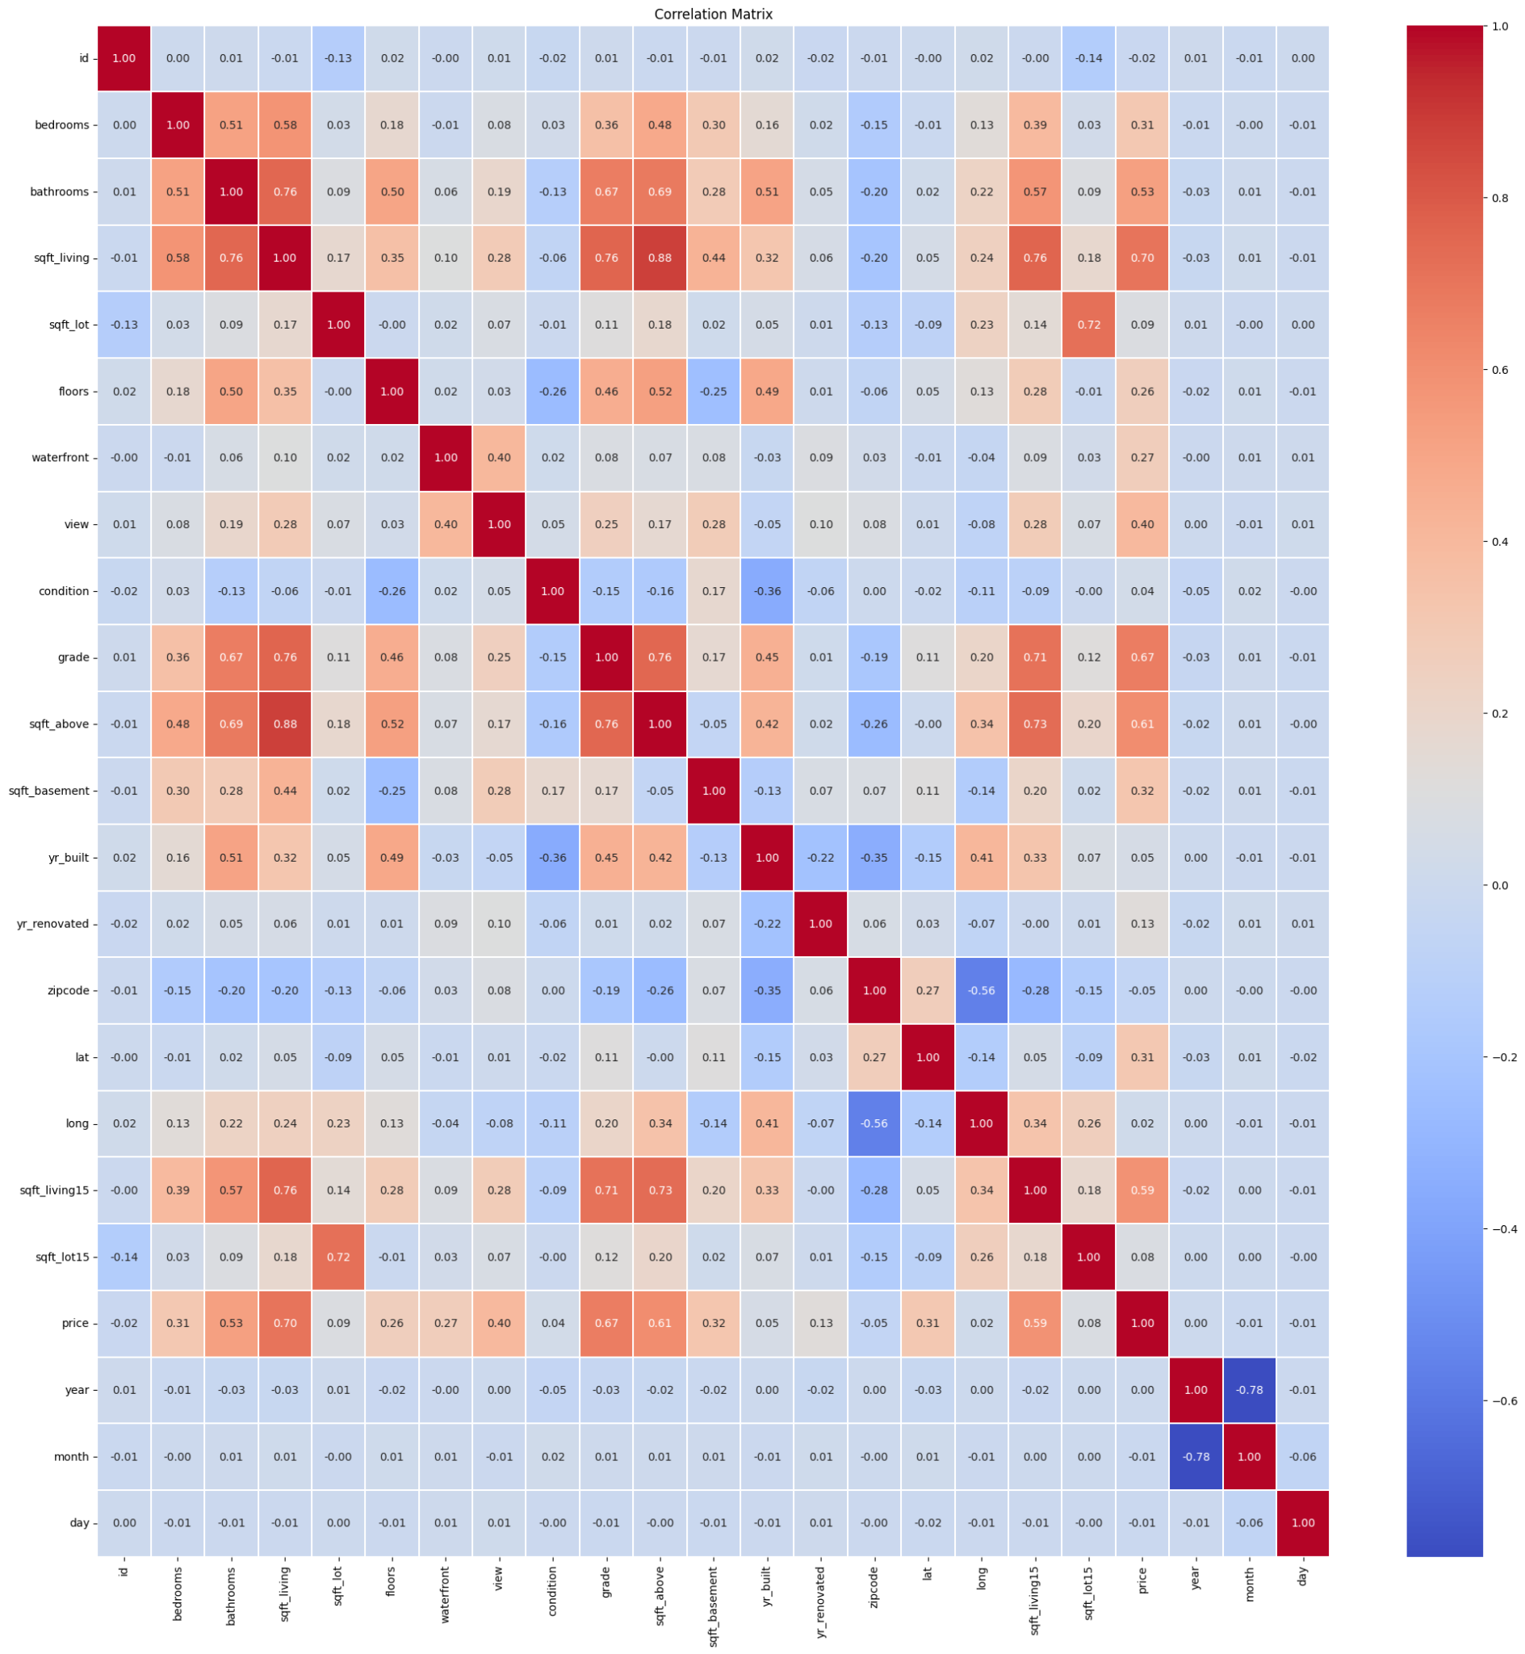
Heat Map

Slide 9
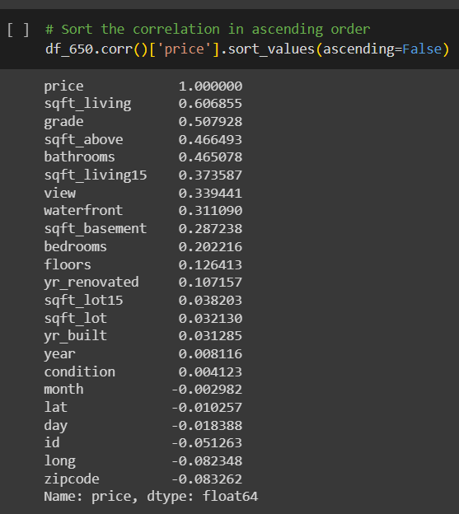
Correlations
We sorted also the correlation between the values too:

Slide 10

Machine Learning
We builded a machine learning model to predict the selling prices of houses based on a variety of features.
We extracted the features that most influenced the prediction of house prices, based on the same features with our target variable (price) . We created our linear regression model to have a good understanding of it. The purpose of this machine learning model is to predict the price of houses by evaluating the metrics between Mean Squared Error (MSE) and R-squared (R²):
Where the Mean Squared Error (MSE): Indicates the average squared difference between predicted and actual values. Our model's MSE is $61,254,344,139.52, reflecting the accuracy of predictions. And the R-squared (R²): A measure of how well the model explains the variance in the target variable. Our model has an R² of 0.53, indicating moderate predictive power.

Slide 11
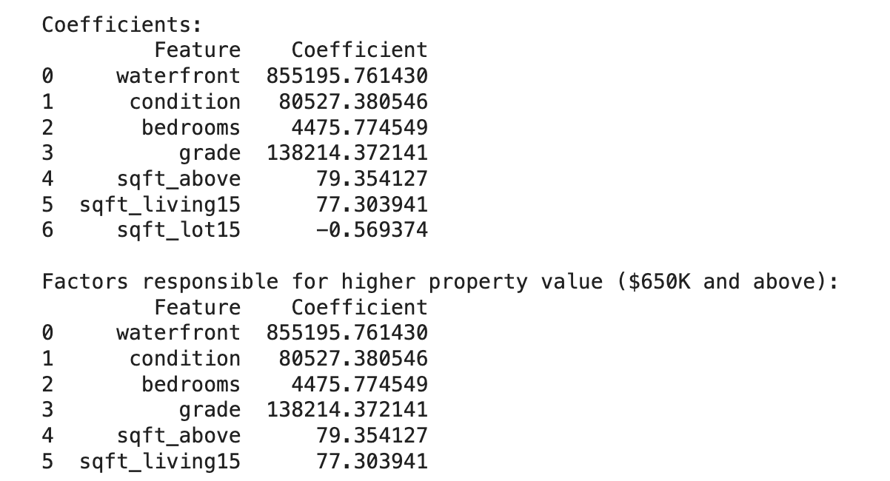
Machine Learning
Then we highlight the features that clearly contribute to the house prices of 650k and above.
Key features.
-Waterfront: Strong positive influence with a coefficient of $855,195.76.
-Condition: Positive impact with a coefficient of $80,527.38.
-Bedrooms: Positive impact with a coefficient of $4,475.77.
-Grade: Significant positive influence with a coefficient of $138,214.37.
-Sqft_Above: Positive impact with a coefficient of $79.35.
-Sqft_Living15: Positive impact with a coefficient of $77.30.
-Sqft_Lot15: Negative influence with a coefficient of -$0.57

Slide 12
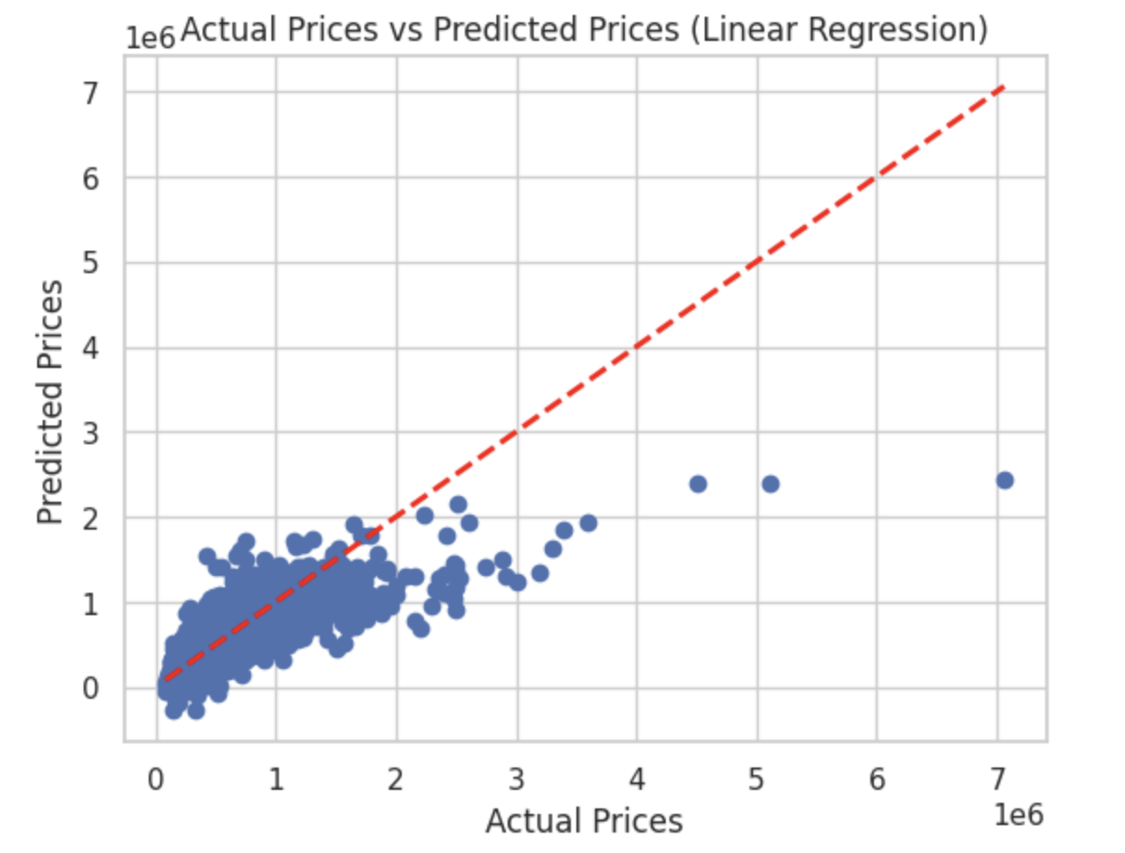
Scatter Plot

Slide 13
Conclusions
-Each point on the plot represents an individual house property.
-The diagonal red line represents a perfect prediction scenario where actual price and predicted prices are equal.
-Points above the red line indicate overestimation, while points below the line indicate a massive error.
-Wider dispersion from the line indicates the areas where the model struggles to predict accurately.

Slide 14
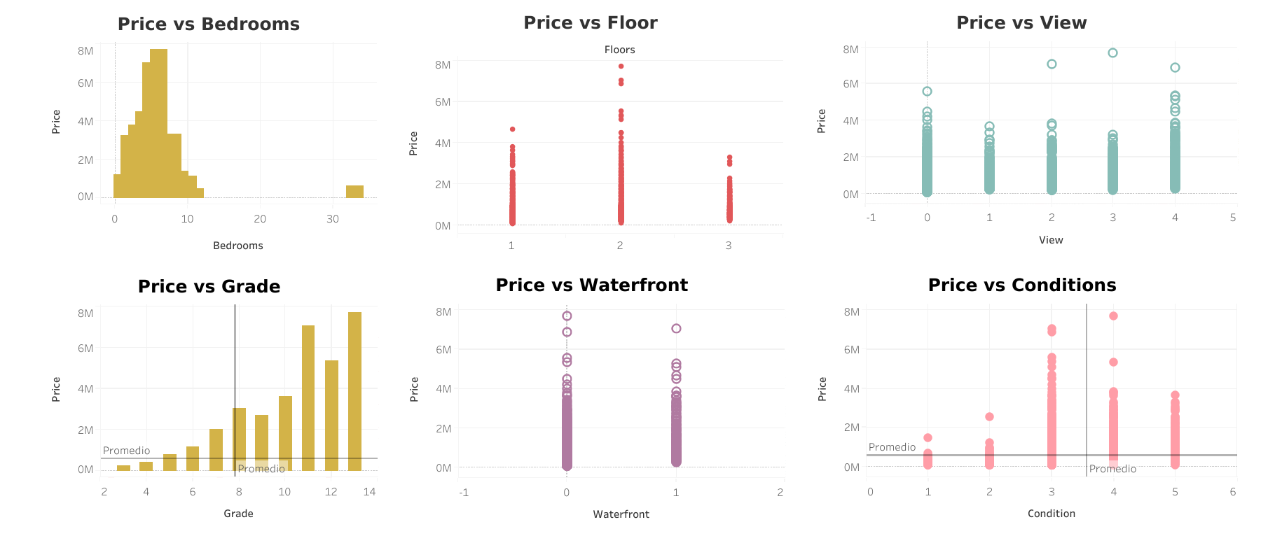
Dashboards

Slide 15
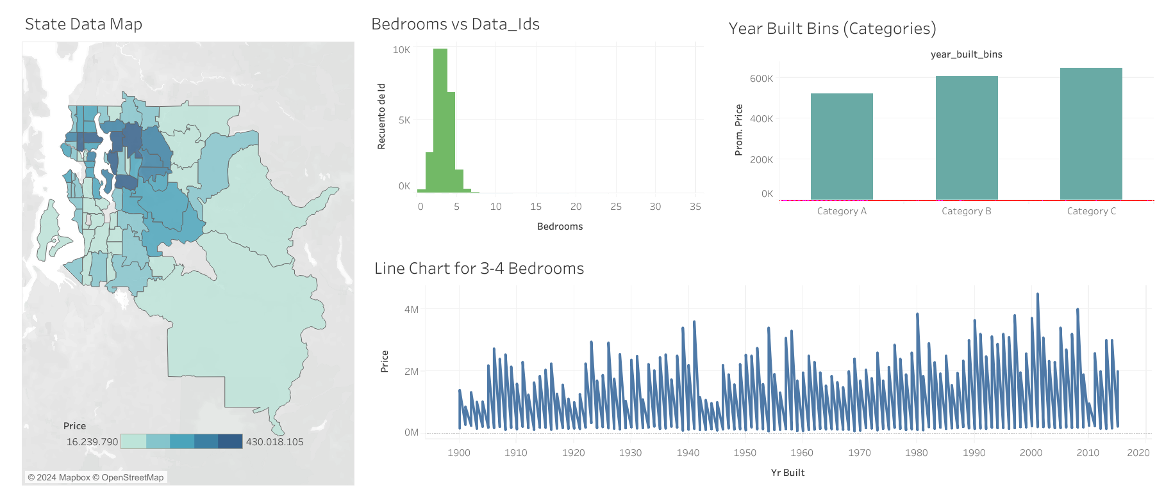

Slide 16
